Slide 1



Extreme-Scale Software Overview
Padma Raghavan
The Pennsylvania State University
Peking University, Sept 26-29, 2011
China-USA Computer Software Workshop
National Natural Science
Foundation of China (NSFC)

Slide 2
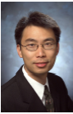
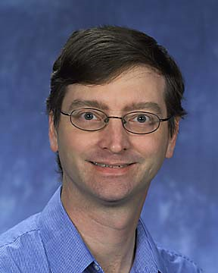
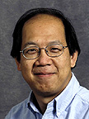
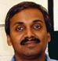
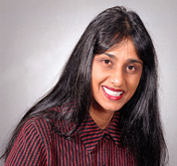
Participants and Themes
Edmond Chow
Bill Gropp
Esmond Ng
Abani Patra
Padma Raghavan
Performance
Quality Parallel Scaling Efficiency
Productivity Reliability
Applications Algorithms Data Architecture
Software

Slide 3
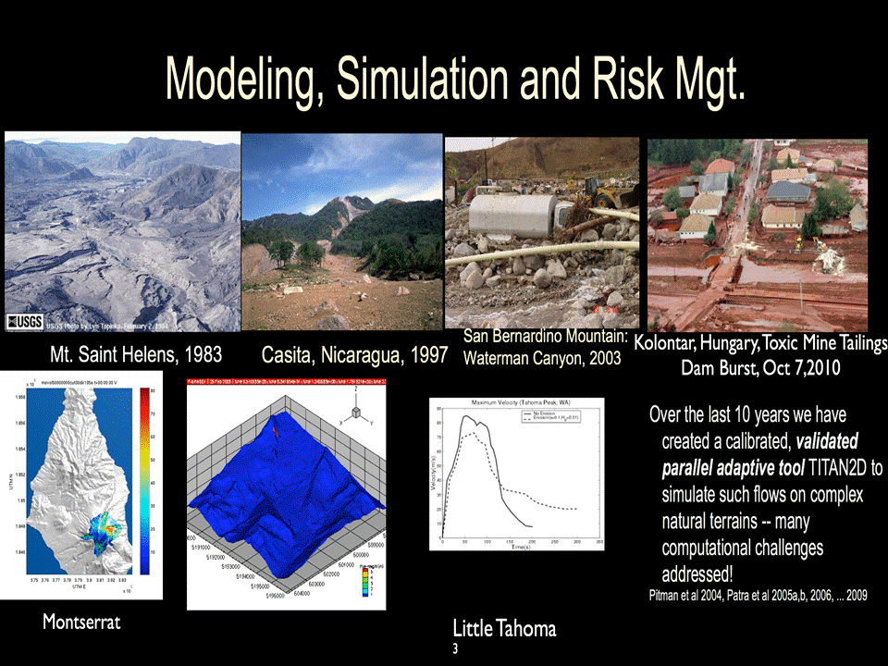
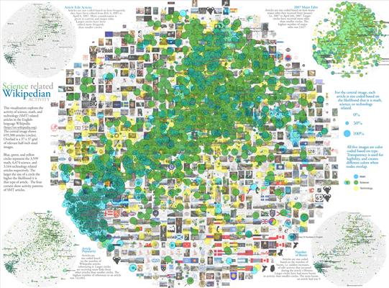
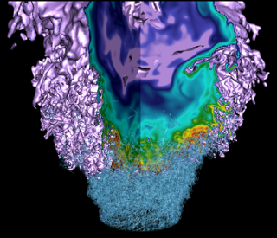
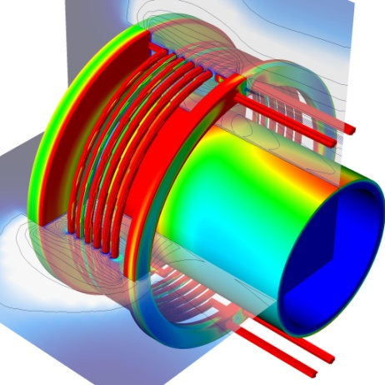

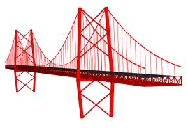
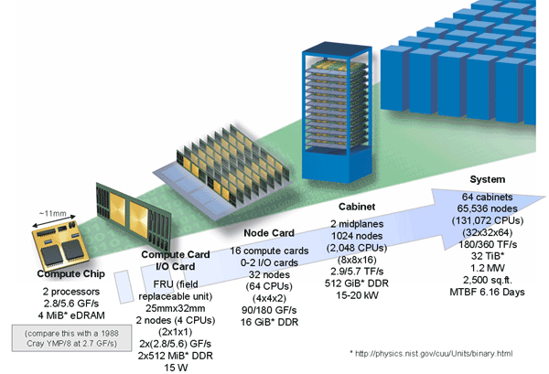
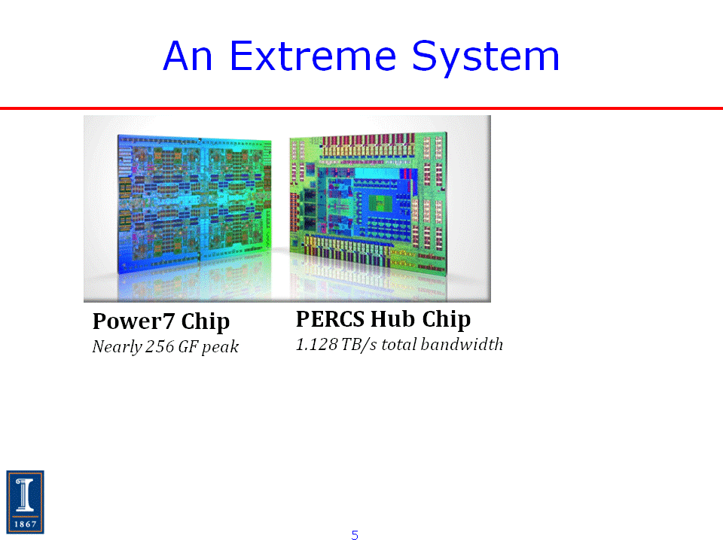
Extreme-Scale Applications
6
9
Time: 10-10 msec—hours
Space: similar range
6
9
10 -10 particles/vertices
mesh points/dimensions
Extreme-Scale Software
6
9
10-10 way parallelism
ILP to thread/core
Spatial locality
determines latencies
Extreme-Scale Systems

Slide 4
Extreme-Scale Applications
Apps can be expressed in terms of common kernels, but
no standard data structures esp. for shared vs local
no standard interfaces for functions
Many algorithms exist per function, different tradeoffs
accuracy vs complexity
parallelism vs convergence
Tradeoffs depend on data – known only at runtime
Extreme-Scale Software Challenges
Abstractions &
super algorithms
Models & measurement
APIs, libraries,
runtime systems & standards
Mapping parallelism between app & h/w
across scales – million-billion way
partition, schedule-- multi-objective
Managing efficiency – time, energy
Predicting nonlinear effects
interference & resource contention
H/W simulators do not scale to multi/many cores
Latencies vary –NUMA, NoC, multi-stage networks
Emerging issues ---soft errors, process variations, heterogeneity, ….
Extreme-Scale Systems

Slide 5
High-Performance Parallel Computing for Scientific Applications
Edmond Chow School of Computational Sci. & Eng. Georgia Institute of Technology
Georgia Institute of Technology
2010-present
Columbia University, 2009-2010
D. E. Shaw Research, 2005-2010
Lawrence Livermore National Laboratory
1998-2005
University of Minnesota, PhD 1998
Contact: echow@cc.gatech.edu

Slide 6
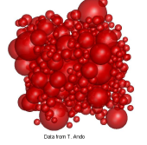
Large-Scale Simulations of Macromolecules in the Cell
Proteins & other molecules
modeled by spheres of different radii
Stokesian dynamics to
model near-and far-range
hydrodynamic interactions
Goal: understand diffusion
and transport mechanisms in the crowded environment of the cell

Slide 7
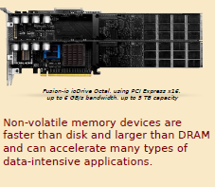
Quantum Chemistry with Flash Memory Computing
Electronic structure codes require two-electron integrals
O(N ) for N basis functions
Many codes must store these on disk, rather than re-compute
Goals:
understand application behavior
reformulate algorithms to exploit flash memory
4

Slide 8
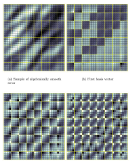
Multilevel Algorithms for Large-Scale Applications
Multilevel algorithms compute and combine
solutions at different scales
Goal: achieve high performance by linking
the structure of the physics to the structure of the algorithms and parallel computer

Slide 9
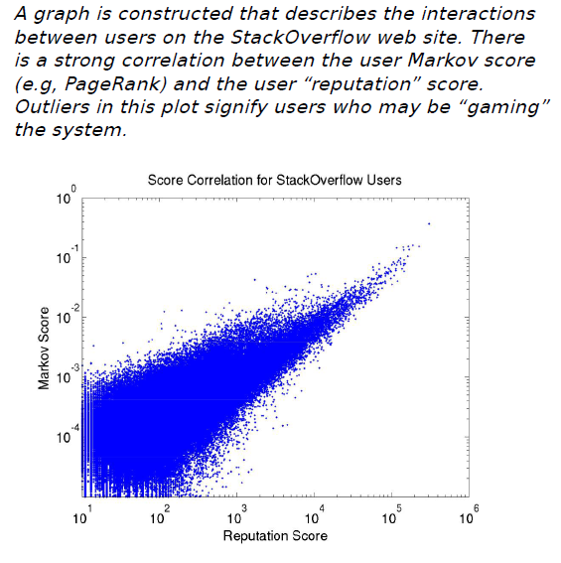
Data-Intensive Computing with Graphical Data
Studying the structure of the links between inter-related entities such as web pages can yield astonishing insights
Challenge: There are small, important pieces of information hidden in vast amounts of graphical data than can be very difficult to find

Slide 10

Performance Modeling as the Key to Extreme Scale Computing
William Gropp
Paul and Cynthia Saylor Professor of Computer Science
University of Illinois
Deputy Director for Research Institute for Advanced Computing Applications and Technologies Director, Parallel Computing Institute
www.cs.illinois.edu/~wgropp
National Academy of Engineering ACM Fellow, IEEE Fellow SIAM Fellow

Slide 11
Tuning A Parallel Code
Typical Approach
Profile code: Determine where most time is being spent
Improve code: Reduce time spent in “unproductive” operations
Why is this NOT right? How do you know:
When you are done?
How much performance improvement you can obtain?
What is the goal?
It is insight into whether a code is achieving the performance it could, and if not, how to fix it

Slide 12
Why Model Performance?
Two different models --- two analytic expressions
First, based on the application code
Second, based on the application’s algorithm and data structures
Why this sort of modeling ?
Can extrapolate to other systems
Nodes with different memory subsystems
Different interconnects
Can compare models & observed performance to identify
Inefficiencies in compilation/runtime
Mismatch in developer expectations

Slide 13
Bill’s Methodology
Combine analytical methods & performance measurement
Programmer specifies parameterized expectation
e.g., T = a+b*N³
Estimate coefficients with appropriate benchmarks
Fill in the constants with empirical measurements
Focus on upper & lower bounds (not on precise predictions)
Make models as simple and effective as possible
Simplicity increases the insight
Precision needs to be just good enough to drive action.

Slide 14
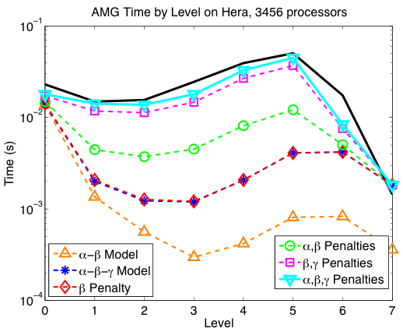
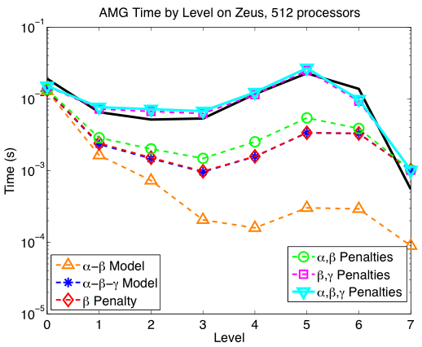
Example: AMG Performance Model
What if a model is too difficult?
Establish upper & lower bounds
Compare performance
Includes contention, bandwidth, multicore penalties
82% accuracy on Hera, 98% on Zeus
Gahvari, Baker, Schulz, Yang, Jordan, Gropp (ICS’11)

Slide 15
FASTMath Scidac Institute Overview
Esmond G. Ng Lawrence Berkeley National Laboratory Computational Research Division
Projects:
FASTMath
BISICLES – High-Performance Adaptive Algorithms for Ice-Sheet Modeling
UNEDF (nuclear physics), ComPASS (accelerator)
http://crd.lbl.gov/~EGNg

Slide 16
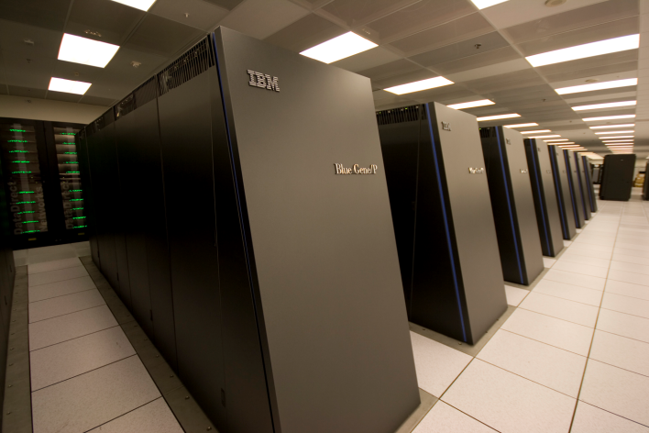
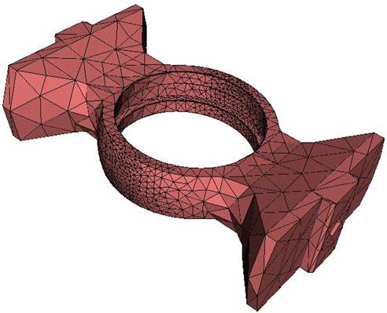
FASTMath Objectives
The FASTMath SciDAC Institute will develop and deploy scalable mathematical algorithms and software tools for reliable simulation of complex physical phenomena and will collaborate with DOE domain scientists to ensure the usefulness and applicability of FASTMath technologies
Notes:
CASC’s mission is to conduct research that embraces HPC and scalable/efficient computational methods. All this focused on programmatic objectives.

Slide 17
FASTMath will help application scientists overcome two fundamental challenges
Improve the quality of their simulations
Increase accuracy
Increase physical fidelity
Improve robustness and reliability
Adapt computations to make effective use of supercomputers
Million way parallelism
Multi-/many-core nodes
FASTMath will help address both challenges by focusing on the interactions among mathematical algorithms, software design, and computer architectures
Notes:
So let’s talk about the applications and applications drivers.
Science, engineering, and systems simulation drive our research. These tools are essential for the all programs at LLNL.
Shock physics, hydrodynamics, modeling high-Z materials, climate modeling, fusion modeling represent a few of the applications. Important examples might include QBOX, used for materials modeling for program or ALE3D. These range from small science codes used for materials modeling to large multiphysics packages used for systems model.
If we abstract out how the applications drive our research, you see 3 basic themes:
Model complexity to integrate more complex physical simulations, could include UQ as well (adding hydro, material properties, etc. )
Performance scalability to simulate rapidly and efficiency (Gordon Bell prize Qbox)
Increasing insight into massive data sets, either from intelligence data which often takes the form of large graphs for from simulation

Slide 18
FASTMath encompasses three broad topical areas
Tools for problem discretization
Structured grid technologies
Unstructured grid technologies
Adaptive mesh refinement
Complex geometry
High-order discretizations
Particle methods
Time integration
Solution of algebraic systems
Iterative solution of linear systems
Direct solution of linear systems
Nonlinear systems
Eigensystems
Differential Variational Inequalities
High-level integrated capabilities
Adaptivity through the software stack
Coupling different solution algorithms
Coupling different physical domains

Slide 19










The FASTMath team
Lawrence Berkeley
National Laboratory
Lawrence Livermore National Laboratory
Argonne National Laboratory
Ann Almgren
John Bell
Phil Colella
Dan Graves
Sherry Li
Terry Ligocki
Mike Lijewski
Peter McCorquodale
Esmond Ng
Brian Van Straalen
Chao Yang
Lori Diachin
Milo Dorr
Rob Falgout
Jeff Hittinger
Mark Miller
Carol Woodward
Ulrike Yang
Mihai Anitescu
Lois Curfman McInnes
Todd Munson
Barry Smith
Tim Tautges
Rensselear Polytechnic Institute
Berkeley University
Mark Shephard
Onkar Sahni
Jim Demmel
Southern Methodist University
Sandia National Laboratories
University of British Columbia
Dan Reynolds
Karen Devine
Jonathan Hu
Vitus Leung
Andrew Salinger
Carl Ollivier-Gooch
Colorado University at Boulder
Columbia University
Ken Jansen
Mark Adams

Slide 20
Extreme Computing and Applications
Abani Patra
Professor of Mechanical & Aerospace Engineering
University at Buffalo, SUNY
Geophysical Mass Flow Group, SUNY
NSF Office of Cyberinfrastructure, Program Director 2007-2010
abani@eng.buffalo.edu

Slide 21
Applications at Extreme Scale
Critical Applications
hazardous natural flows, volcanic ash transport, automotive safety design, Glacier Lake flood
New Numerical methods, e.g.
particle based methods
adaptive unstructured grids
Uncertainty quantification for computer models (parameters, models …)
Big DATA! Simulation+ Analytics =Workflow optimizations

Slide 22
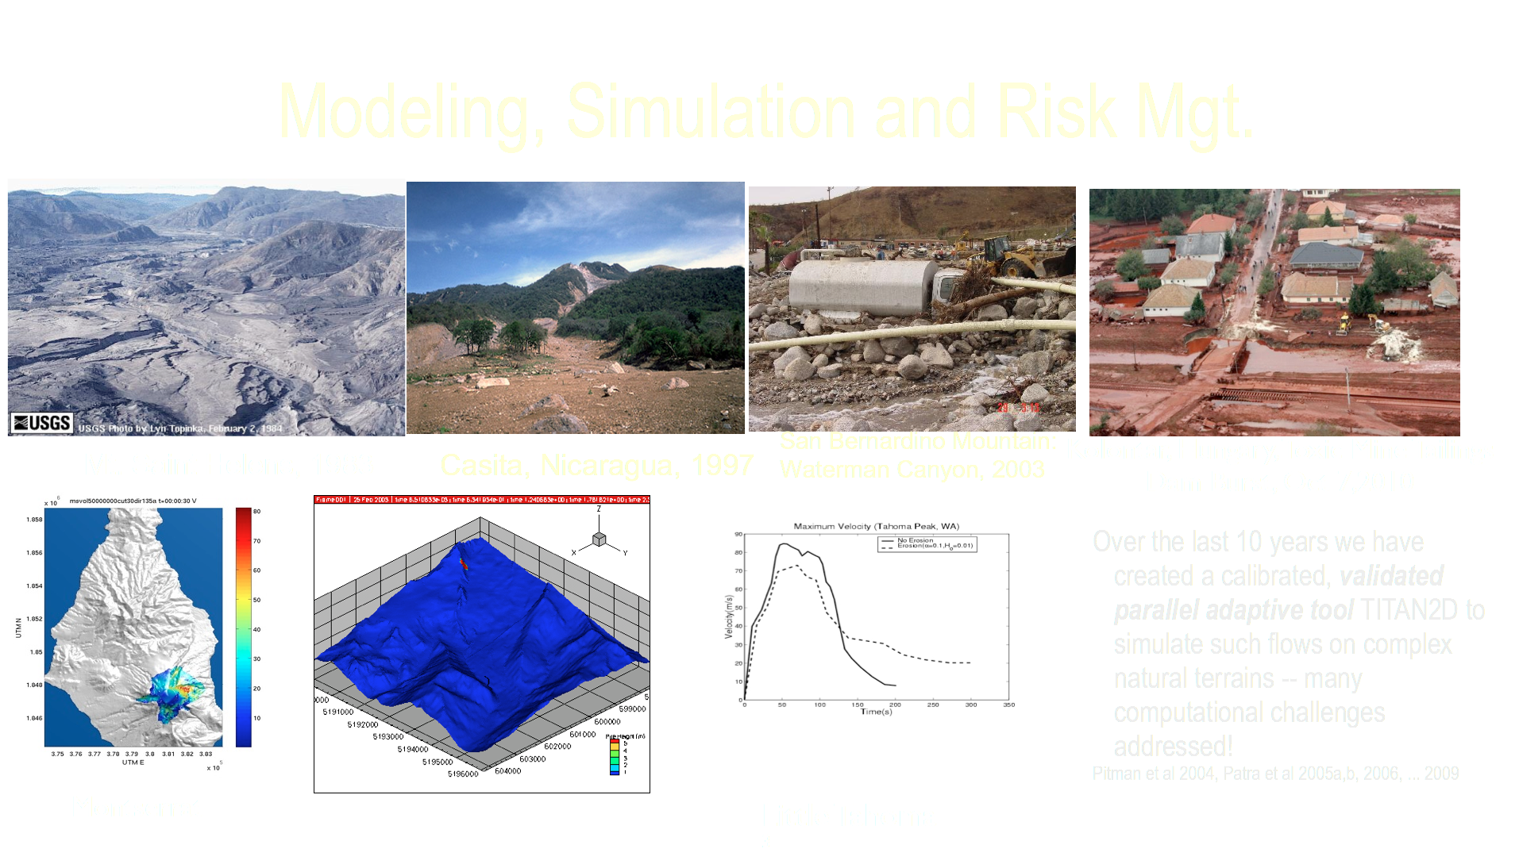

Slide 23
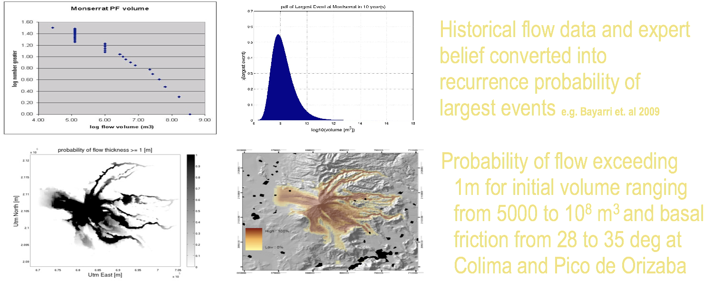
Hazard Map Construction

Slide 24
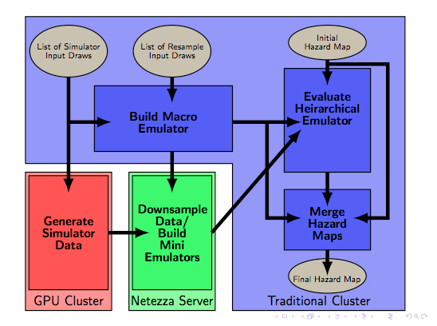
Workflow Parallelization
Each stage parallelized by
master worker allocating tasks to available CPUs
I/O contention is serious issue
100 of files, 10 GB size
Only critical inter-stage files are shared, rest are local
Stage 1, TITAN simulations scale well, 6 hours on 1024 processors
Stage 3, Emulator is near real-time on 512 processors
Simulation + Emulation strategy provides fast predictive capability

Slide 25

Exploiting Sparsity for Extreme Scale Computing
Padma Raghavan
Professor of Computer Science & Engineering
Pennsylvania State University
Director,
Institute for CyberScience Director,
Scalable Computing Lab
www.cse.psu.edu/~raghavan

Slide 26
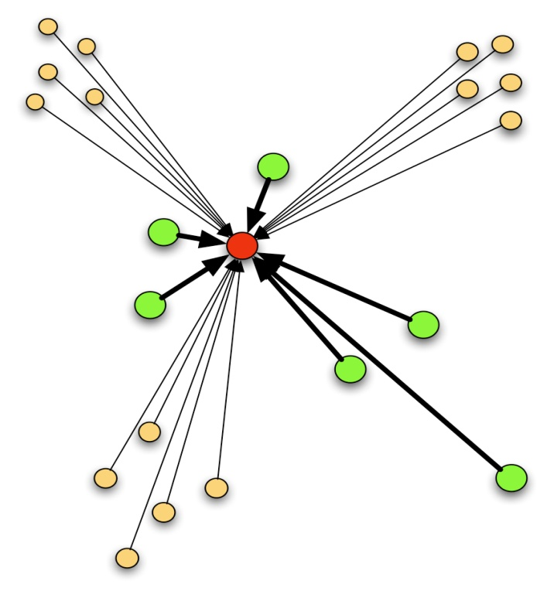
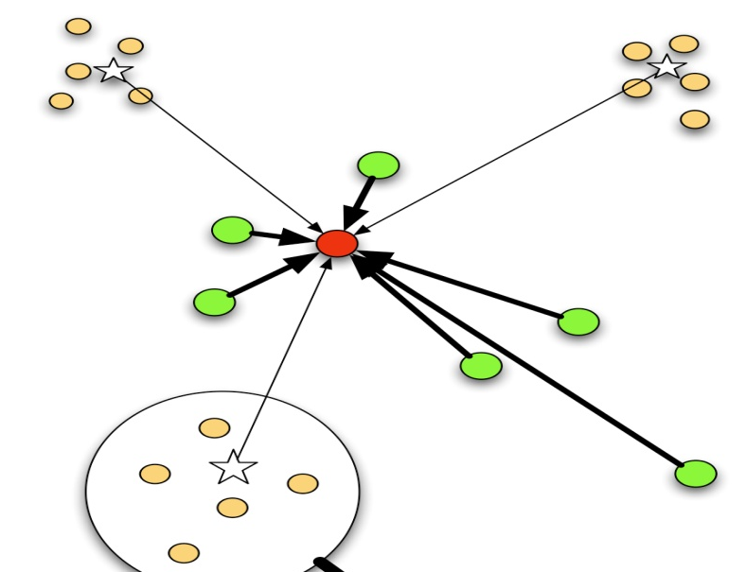
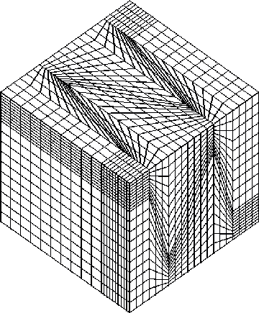

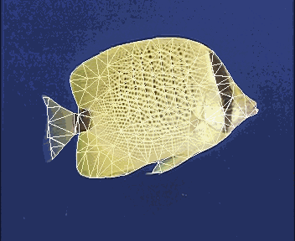
What is Sparsity?
Data are sparse, e.g, NxN paired interactions
Dense: N elements: Sparse: ~30 N elements
2
from
approximations
Examples of sparse data
Discretizing continnum
models
Mining data & text

Slide 27
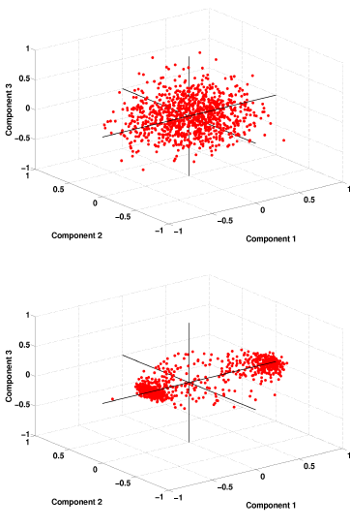
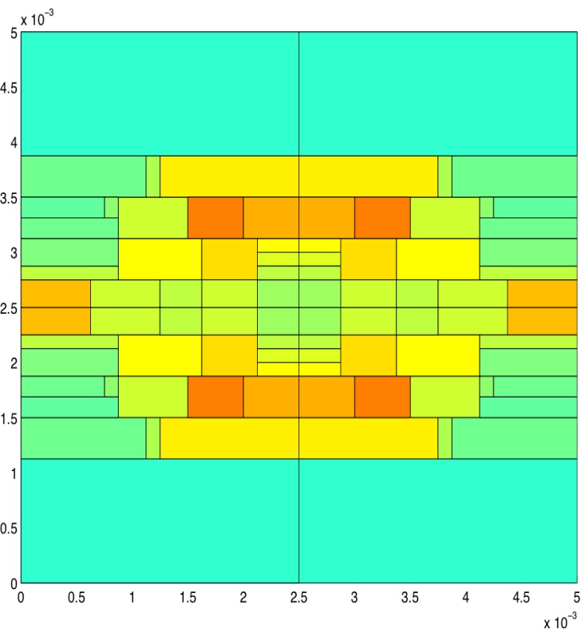
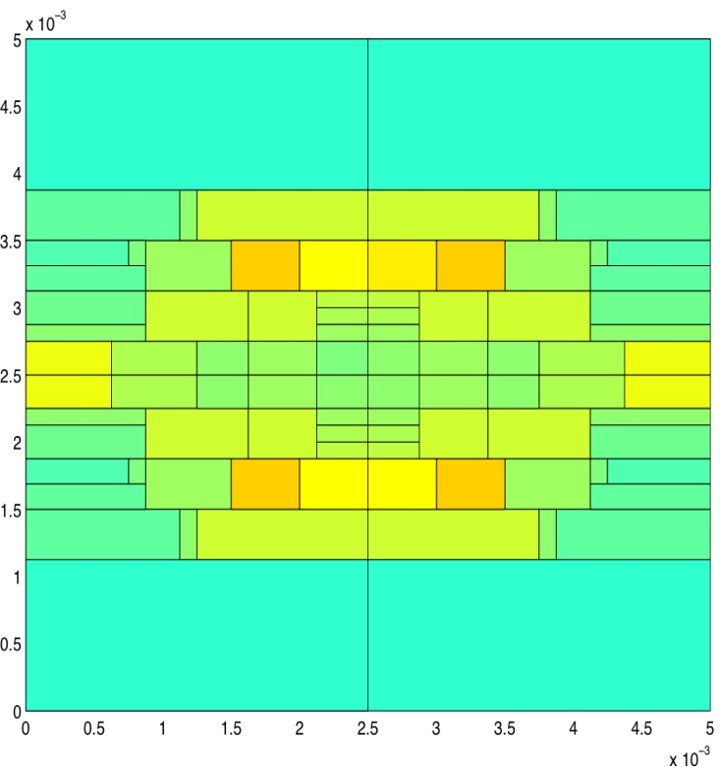
Why exploit Sparsity?
Sparsity= Compact represenation
Memory and compute cost scaling: O(N) per sweep
Goal: Performance, Performance, Performance
Better: Improve
Solution Quality
Faster: Increase
Data Locality
Cheaper: Reduce Power & Cooling Costs
Convert Load Imbalance to Energy Savings by
Dynamic Voltage & Frequency Scaling
Reorder
Data To Improve Locality
Before
Precondition Data To Improve Quality
After

Slide 28
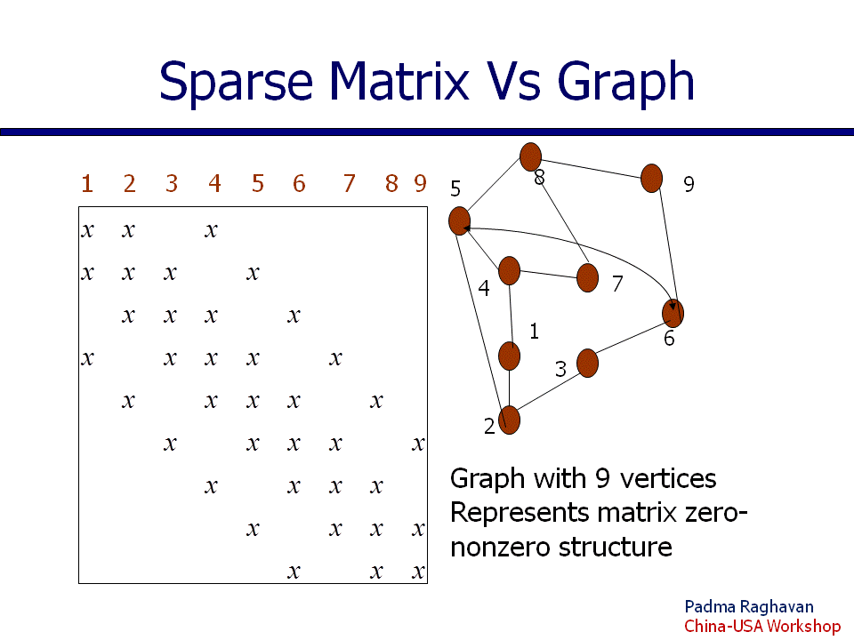
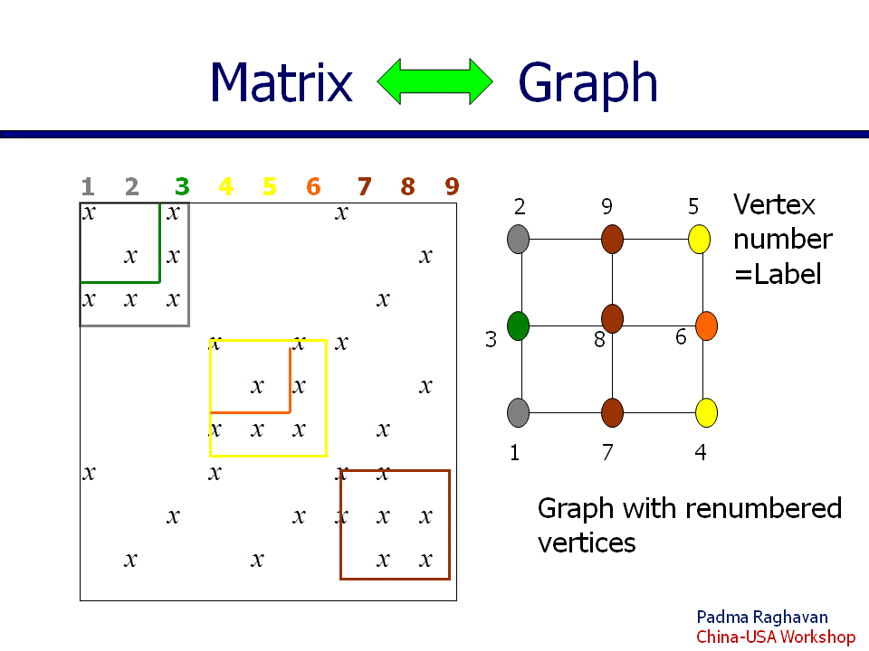
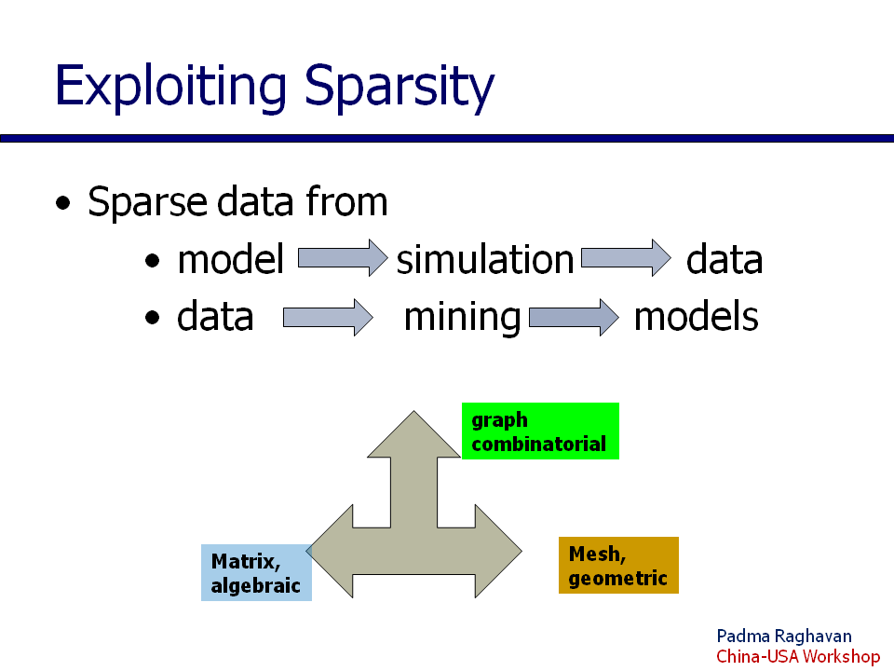
How to exploit Sparsity?
Model “hidden” properties of data
Model performance-relevant feature(s) of
hardware or application
Transform data & algorithm

Slide 29
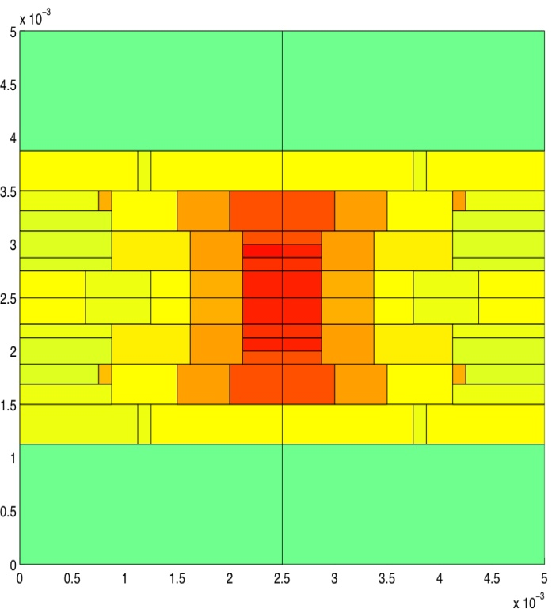
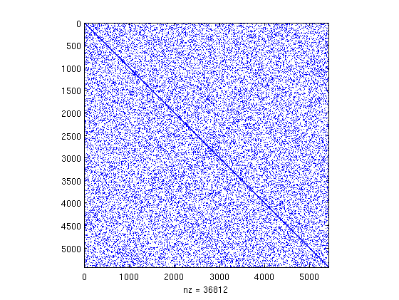
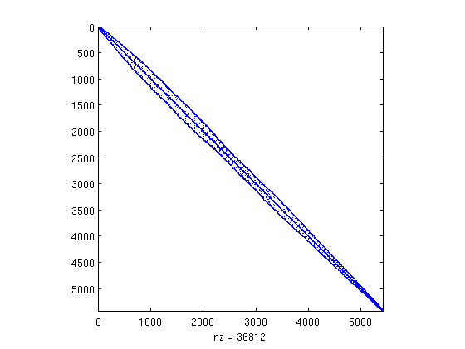
Temperature Evolution (4-core) Dense Benchmark, SMV-Original vs Opt
Temp: 24 C 65 C
SMV- Optimized
Dense Benchmark
SMV-Original
F
I
L
S
I$
D$
(1)
(2)
(3)
SMV-Original
SMV-Opt

Slide 30
Participants and Themes
Edmond Chow
Bill Gropp
Esmond Ng
Abani Patra
Padma Raghavan
Performance
Quality Parallel Scaling Efficiency
Productivity Reliability
Applications Algorithms Data Architecture
Software

